Slide 1
Learning Objective
I will be able to define the arithmetic series
Success Criteria
At the end of the lesson, I will be able to:
define a series as a sum of a sequence;
determine arithmetic sums using a recursive process;
derive the arithmetic sum (series) formula and use it to calculate the sum of n terms;
find the common difference, first term or number of terms, given sufficient information; and
apply arithmetic sums to applied problems involving linear growth and decay.

Slide 2
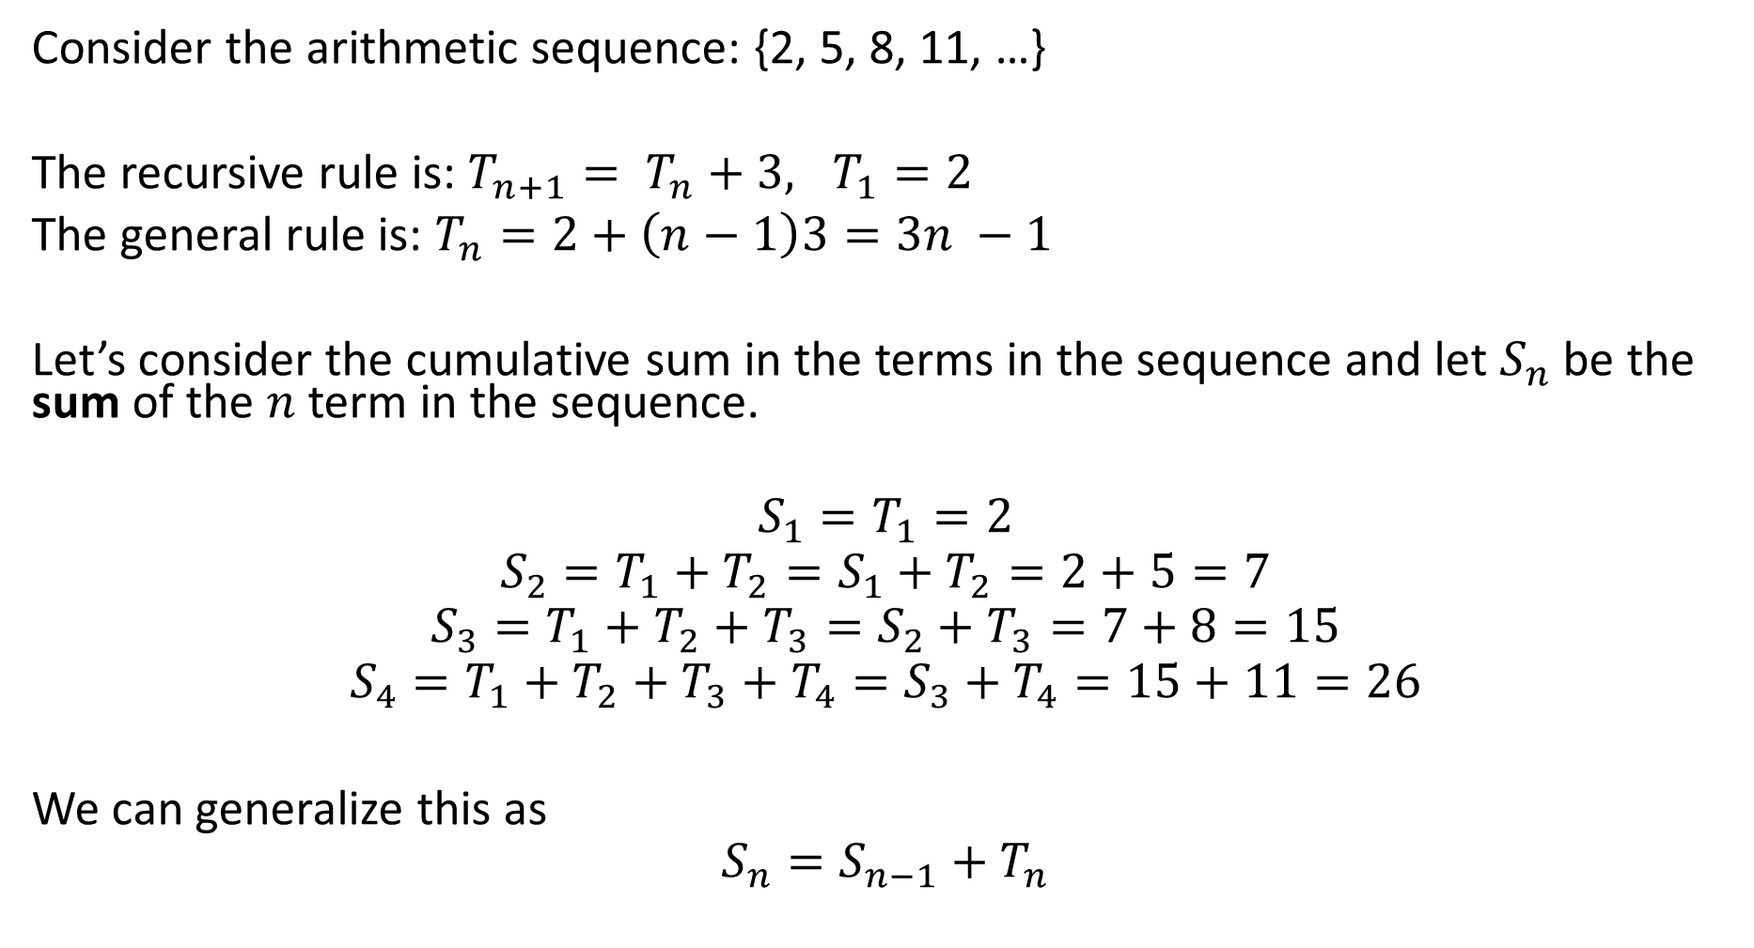
Skill Development
Consider the arithmetic sequence: {2, 5, 8, 11, …}
The recursive rule is: $T_{n+1}= T_{n}+3, T_{1}=2$
The general rule is: $T_{n}=2+\left(n−1\right)3=3n −1$
Let’s consider the cumulative sum in the terms in the sequence and let $S_{n}$ be the sum of the $n$ term in the sequence.
$$S_{1}=T_{1}=2$$
$$S_{2}=T_{1}+T_{2}=S_{1}+T_{2}=2+5=7$$
$$S_{3}=T_{1}+T_{2}+T_{3}=S_{2}+T_{3}=7+8=15$$
$$S_{4}=T_{1}+T_{2}+T_{3}+T_{4}=S_{3}+T_{4}=15+11=26$$
We can generalize this as
$$S_{n}=S_{n−1}+T_{n}$$

Slide 3
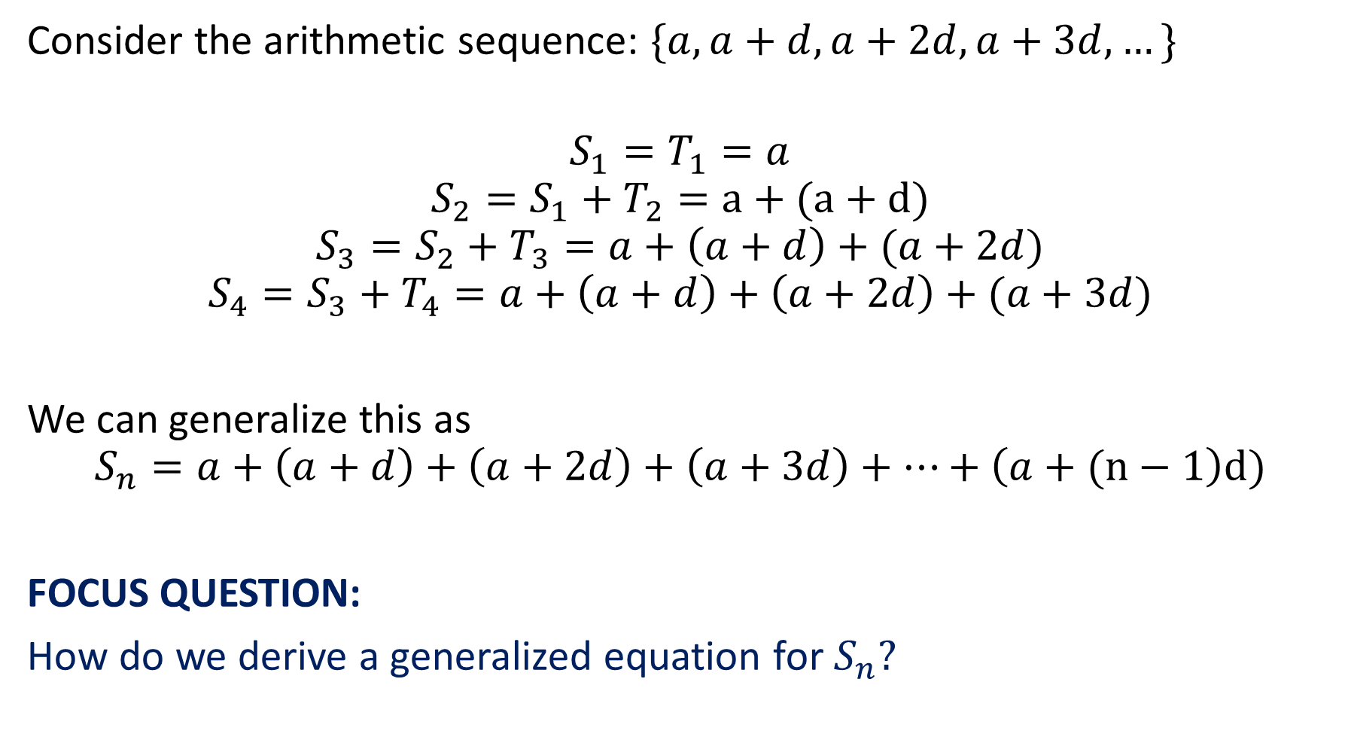
Skill Development
Consider the arithmetic sequence: $\{a, a+d, a+2d, a+3d, …\}$
$$S_{1}=T_{1}=a$$
$$S_{2}=S_{1}+T_{2}=a+(a+d)$$
$$S_{3}=S_{2}+T_{3}=a+\left(a+d\right)+(a+2d)$$
$$S_{4}=S_{3}+T_{4}=a+\left(a+d\right)+\left(a+2d\right)+(a+3d)$$
We can generalize this as
$$S_{n}=a+\left(a+d\right)+\left(a+2d\right)+\left(a+3d\right)+…+\left(a+(n−1\right)d)$$
FOCUS QUESTION:
How do we derive a generalized equation for $S_{n}?$

Slide 4

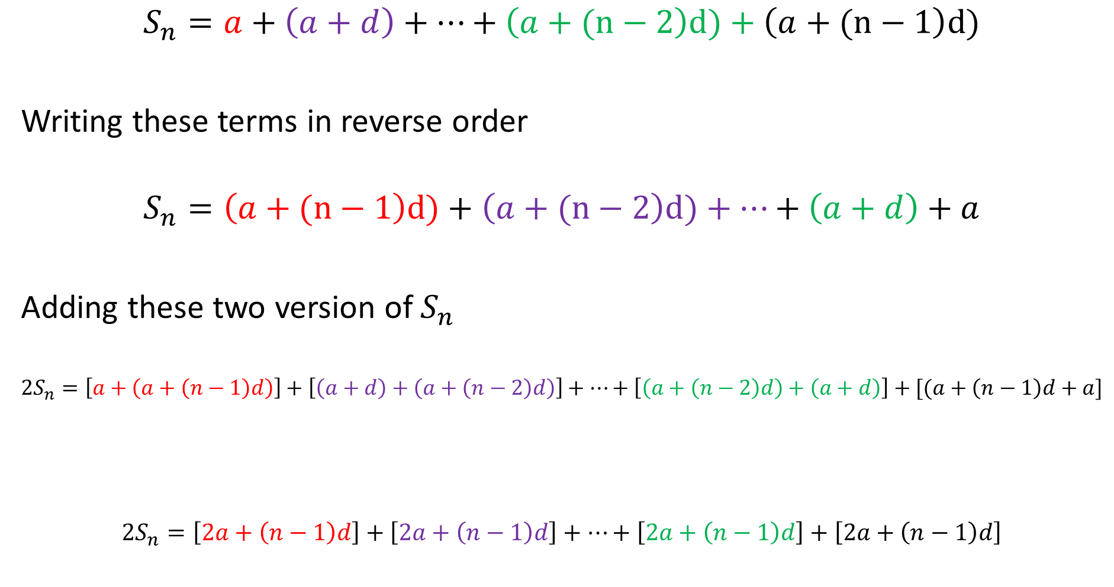

Deriving Generalised Formula:
$$S_{n}=a+\left(a+d\right)+…+\left(a+(n−2\right)d)+\left(a+(n−1\right)d)$$
Writing these terms in reverse order
$$S_{n}=\left(a+(n−1\right)d)+\left(a+(n−2\right)d)+…+\left(a+d\right)+a$$
Adding these two version of $S_{n}$
$${2S}_{n}=\left[a+\left(a+\left(n−1\right)d\right)\right]+\left[\left(a+d\right)+\left(a+\left(n−2\right)d\right)\right]+…+\left[\left(a+\left(n−2\right)d\right)+\left(a+d\right)\right]+[(a+\left(n−1\right)d+a]$$
$2S_{n}=\left[2a+\left(n−1\right)d\right]+$ $\left[2a+\left(n−1\right)d\right]+…+\left[2a+\left(n−1\right)d\right]+\left[2a+\left(n−1\right)d\right]$
$n$ lots of $2a+\left(n−1\right)d$
$${2S}_{n}=n[2a+\left(n−1\right)d]$$

Slide 5
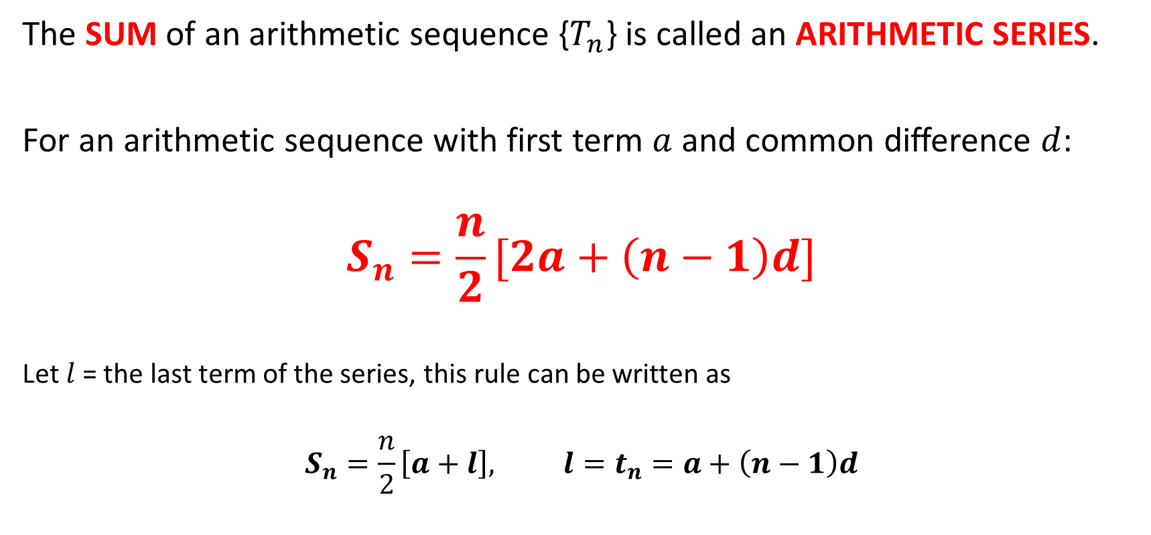
Arithmetic Series
Concept Development
The SUM of an arithmetic sequence {$T_{n}$} is called an ARITHMETIC SERIES.
For an arithmetic sequence with first term $a$ and common difference $d$:
$$S_{n}=\frac{n}{2}[2a+\left(n−1\right)d]$$
Let $l$ = the last term of the series, this rule can be written as
$$S_{n}=\frac{n}{2}\left[a+l\right], l=t_{n}=a+\left(n−1\right)d$$

Slide 6
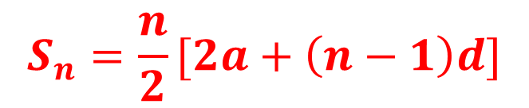


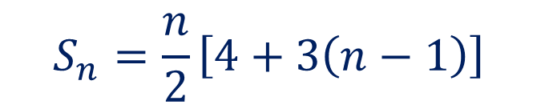

Guided Practice
$$S_{n}=\frac{n}{2}[2a+\left(n−1\right)d]$$
For the arithmetic series {2, 5, 8, 11, …} calculate the sum of the first 14 terms.
$$a=2, d=3$$
$$S_{n}=\frac{n}{2}\left[4+3\left(n−1\right)\right]$$
$$S_{14}=\frac{14}{2}\left[4+3\left(14−1\right)\right]$$
$$S_{14}=301$$

Slide 7
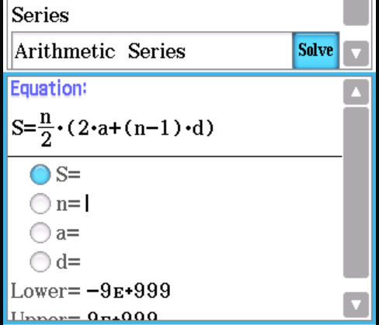
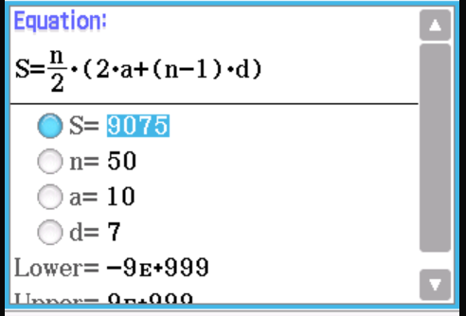
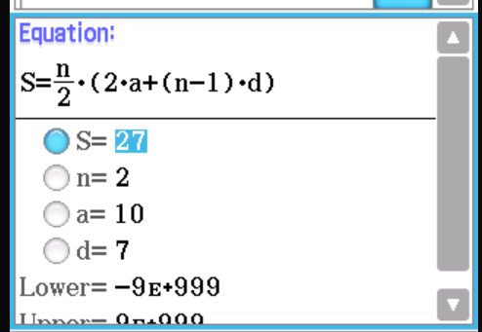


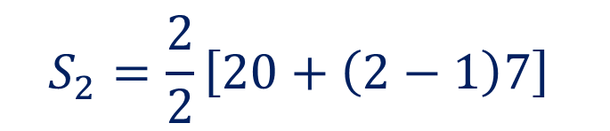
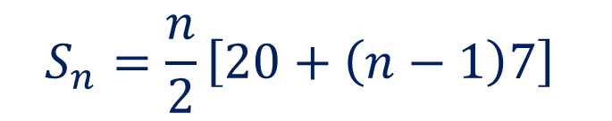


Guided Practice
$$S_{n}=\frac{n}{2}[2a+\left(n−1\right)d]$$
For the arithmetic sequence {10, 17, 24, 31, 38, …}
Determine a) $S_{2}$; b) $S_{50}$
$$a=10, d=7$$
$$S_{n}=\frac{n}{2}\left[20+\left(n−1\right)7\right]$$
$$S_{2}=\frac{2}{2}\left[20+\left(2−1\right)7\right]$$
$$S_{2}=27$$
$$S_{50}=9075$$

Slide 8


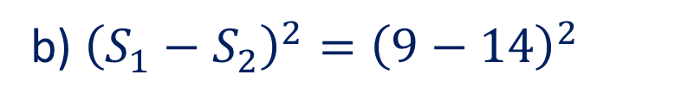
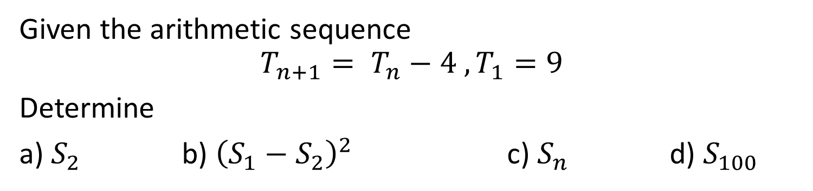
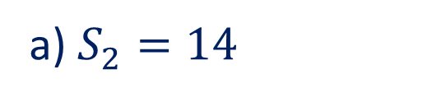
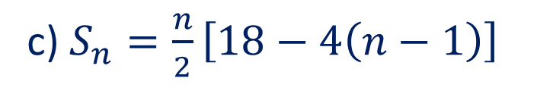
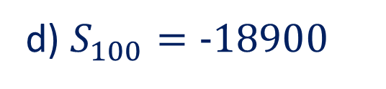
Guided Practice
$$S_{n}=\frac{n}{2}[2a+\left(n−1\right)d]$$
Given the arithmetic sequence
$$T_{n+1}= T_{n}−4 , T_{1}=9$$
Determine
a) $S_{2}$ b) ${\left(S_{1}−S_{2}\right)}^{2}$ c) $S_{n}$ d) $S_{100}$
$$a=9, d=−4$$
c) $S_{n}=\frac{n}{2}\left[18−4\left(n−1\right)\right]$
a) $S_{2}=14$
b) ${\left(S_{1}−S_{2}\right)}^{2}={\left(9−14\right)}^{2}$
$$=25$$
d) $S_{100}=−18900$

Slide 9

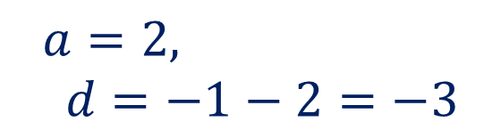

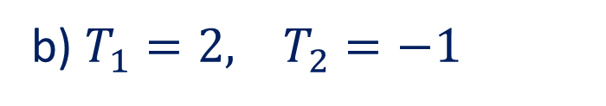





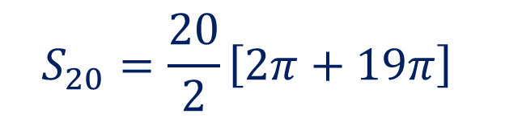
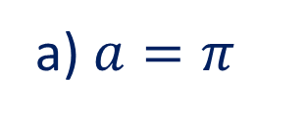
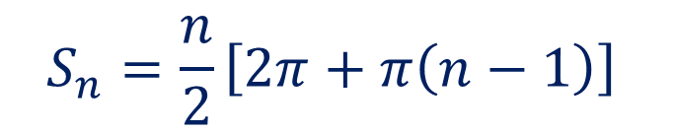
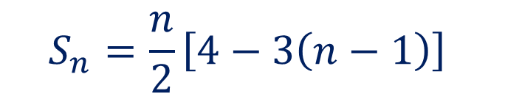
Guided Practice
$$S_{n}=\frac{n}{2}[2a+\left(n−1\right)d]$$
Find the sum of the first 20 terms of an arithmetic sequence with $T_{1}=π$ and $T_{20}=20π$.
Find the sum of the first 40 terms of an arithmetic sequence defined by $T_{n}=5−3n$.
b) $T_{1}=2, T_{2}=−1$
a) $a=π$
$$a=2, d=−1−2=−3$$
$$T_{n}=a+\left(n−1\right)d$$
$$T_{20}=π+\left(20−1\right)d=20π$$
$$S_{n}=\frac{n}{2}\left[4−3\left(n−1\right)\right]$$
$$π+\left(19\right)d=20π$$
$$d=π$$
$$S_{40}=−2260$$
$$S_{n}=\frac{n}{2}\left[2π+π\left(n−1\right)\right]$$
$$S_{20}=\frac{20}{2}\left[2π+19π\right]$$
$$S_{20}=210π$$

Slide 10
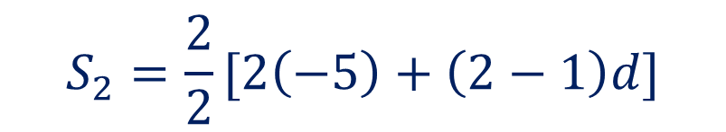

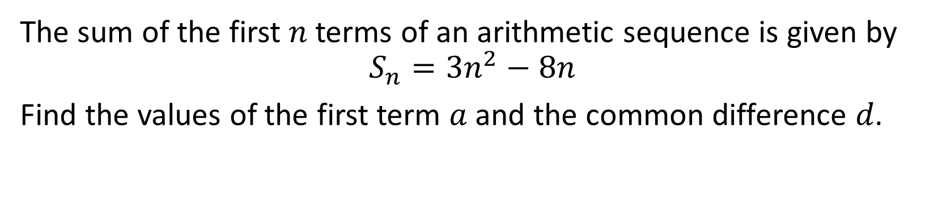





Guided Practice
$$S_{n}=\frac{n}{2}[2a+\left(n−1\right)d]$$
The sum of the first 𝑛 terms of an arithmetic sequence is given by
$$S_{n}=3n^{2}−8n$$
Find the values of the first term 𝑎 and the common difference 𝑑.
$$S_{1}=−5$$
$$S_{1}=T_{1}=−5$$
$$∴a=−5$$
$$S_{2}=−4$$
$$S_{2}=\frac{2}{2}[2\left(−5\right)+\left(2−1\right)d]$$
$$−4=−10+d$$
$$d=6$$

Slide 11




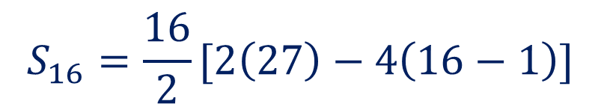
Guided Practice
$$S_{n}=\frac{n}{2}[2a+\left(n−1\right)d]$$
For the arithmetic series {27, 23, 19, 15, …,-33} calculate the number of terms and the sum of the terms.
$$a=27, d=−4$$
$$S_{16}=\frac{16}{2}[2\left(27\right)−4\left(16−1\right)]$$
$$T_{n}=a+\left(n−1\right)d$$
$$S_{16}=−48$$
$$T_{n}=−33=27−4\left(n−1\right)$$
$$−60=−4\left(n−1\right)$$
$$n−1=15 \\ n=16$$
Number of terms = 16

Slide 12









Guided Practice
$$S_{n}=\frac{n}{2}[2a+\left(n−1\right)d]$$
For the arithmetic series {3, 6, 9, 12, …} calculate:
The sum of the first 25 terms
The number of terms in the series if $S_{n}=1395$
$$a=3, d=3$$
$$S_{25}=\frac{25}{2}\left[2\left(3\right)+\left(25−1\right)\left(3\right)\right]$$
$$n^{2}+n−930=0$$
$$\left(n−30\right)\left(n+31\right)=0$$
$$=975$$
$$n=30, n=−31 (reject as n>0)$$
$$S_{n}=\frac{n}{2}\left[6+3\left(n−1\right)\right]=1395$$
$∴$ number of terms in the series is 30
$$n\left[3n+3\right]=2790$$
$$3n^{2}+3n−2790=0$$

Slide 13






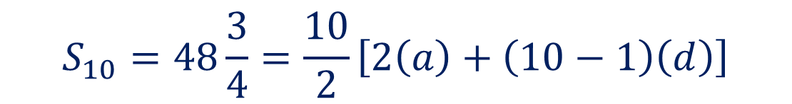


Guided Practice
$$S_{n}=\frac{n}{2}[2a+\left(n−1\right)d]$$
The sum of the first 10 terms of an arithmetic sequence is $48\frac{3}{4}$. If the fourth term is $3\frac{3}{4},$ find the first term and the common difference.
$$S_{10}=48\frac{3}{4}=\frac{10}{2}\left[2\left(a\right)+\left(10−1\right)\left(d\right)\right]$$
$$T_{4}=3\frac{3}{4}=a+\left(4−1\right)d$$
$$\frac{15}{4}=a+3d$$
$$\frac{195}{4}=\frac{10}{2}(2a+9d)$$
$$15=4a+12d −−(2)$$
$$195=20(2a+9d)$$
$$\left(2\right)×10, 150=40a+120d −−(3)$$
$$195=40a+180d −−(1)$$
$$15=4a+12\left(\frac{3}{4}\right)$$
$$\left(1\right)−\left(3\right), 45=60d$$
$$d=\frac{3}{4}$$
$$a=\frac{3}{2}$$

Slide 14

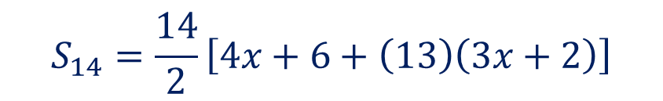

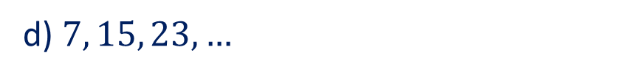

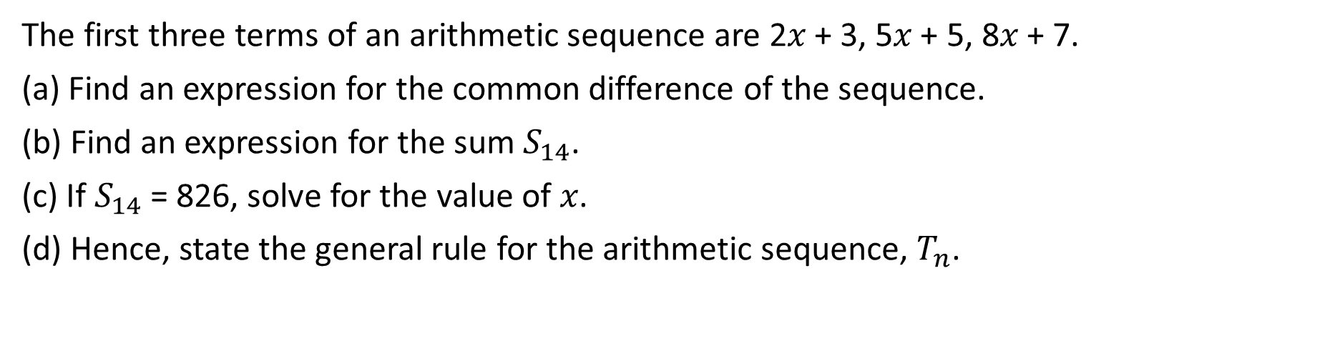

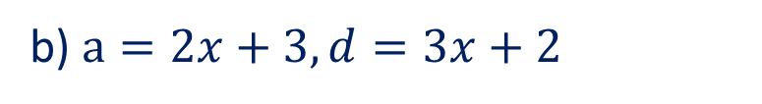
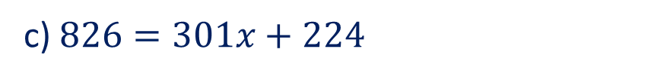


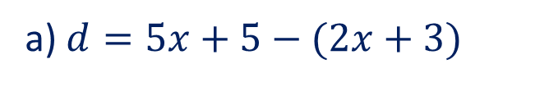

Guided Practice
$$S_{n}=\frac{n}{2}[2a+\left(n−1\right)d]$$
The first three terms of an arithmetic sequence are 2𝑥 + 3, 5𝑥 + 5, 8𝑥 + 7.
(a) Find an expression for the common difference of the sequence.
(b) Find an expression for the sum $S_{14}$.
(c) If $S_{14}$ = 826, solve for the value of 𝑥.
(d) Hence, state the general rule for the arithmetic sequence, $T_{n}$.
a) $d=5x+5−(2x+3)$
c) $826=301x+224$
$$d=3x+2$$
b) $a=2x+3, d=3x+2$
d) $7, 15, 23, …$
$$S_{n}=\frac{n}{2}\left[2\left(2x+3\right)+\left(n−1\right)\left(3x+2\right)\right]$$
$$a=7, d=8$$
$$T_{n}=a+\left(n−1\right)d$$
$$S_{14}=\frac{14}{2}\left[4x+6+\left(13\right)\left(3x+2\right)\right]$$
$$T_{n}=7+8\left(n−1\right)$$
$$S_{14}=7\left[4x+6+39x+26\right]$$
$$T_{n}=−1+8n$$
$$S_{14}=7\left[43x+32\right]=301x+224$$

Slide 15

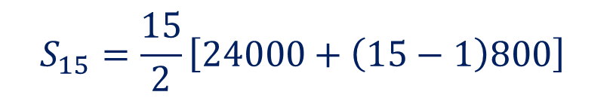


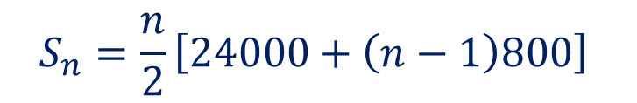
Guided Practice
$$S_{n}=\frac{n}{2}[2a+\left(n−1\right)d]$$
A fifteen-year service contract involves a company paying $12000 in the first year of a contract with an annual increase of $800 every year after that for the life of the contract. Determine the amount the company have paid on this contract in total by the end of the contract.
$$a=12 000$$
$$d=800$$
$$S_{n}=\frac{n}{2}\left[24000+\left(n−1\right)800\right]$$
$$S_{15}=\frac{15}{2}\left[24000+\left(15−1\right)800\right]$$
$$S_{15}=\$264000$$

Slide 16
Guided Practice
$$S_{n}=\frac{n}{2}[2a+\left(n−1\right)d]$$
Max borrows $24000 from his parents to buy a new car. They agree that at the end of each month, the remaining balance is calculated, and Max pay 1% of this remaining balance as interest payments, and then $1000 to reduce the remaining balance. In this way, the loan would be repaid in two years. Determine the amount of interest Ma has to pay his parents.
End of month | 1 | 2 | 3 | … | 23 | 24
Remaining
Interest (1% of balance)

Slide 17
Independent Practice
Complete Cambridge Ex 15C

